Slide 1
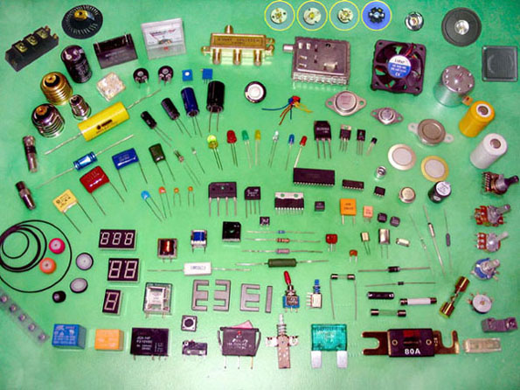
Electronics Lab

Slide 2
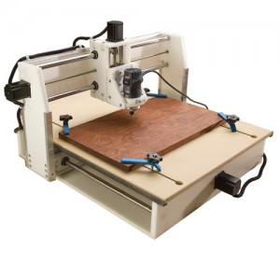
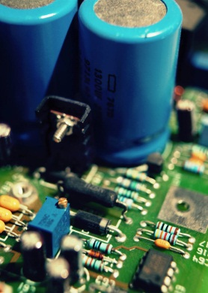
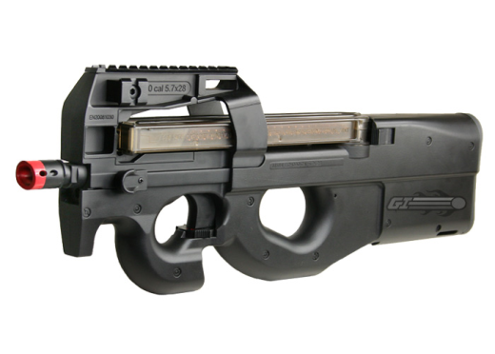
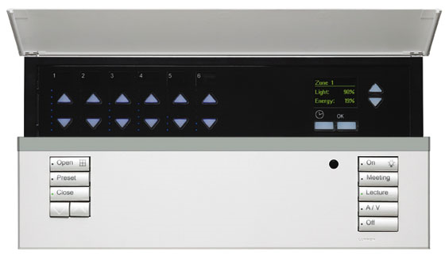
Marc Lichtman
Senior in Electrical Engineering
Hobbies:
  Electronics
  CNC
  Airsoft
Lutron Electronics Co-op

Slide 3
About This Lab
Strictly Practical
  Less design, more building and hacking
  Less math, more formulas
  Cheat all you want
Not a Lecture- use Wikipedia to learn specifics
Different component every week
You will make circuits that do something
DC based circuits
Fun

Slide 4
Why Participate?
Electronics
  Fun and low cost hobby (sample parts for free)
  Very applicable knowledge for all engineers
This Lab
  Easy way to get started in electronics
  Everything is provided (components and tools)
  You can pick at my brain
  For future ECE’s- get ahead of the game

Slide 5

ONLY COME IF YOU ARE INTERESTED

Slide 6
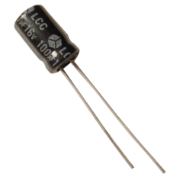
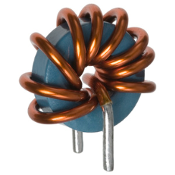
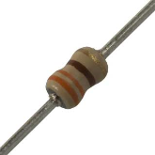
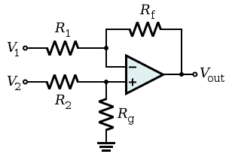

Can you….
Identify a capacitor
Wire and build a circuit, given a schematic
Use a premade circuit and formula to come up with your own unique schematic

Slide 7
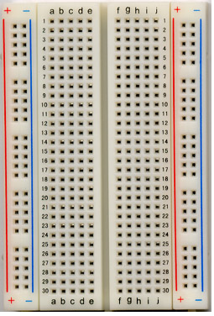
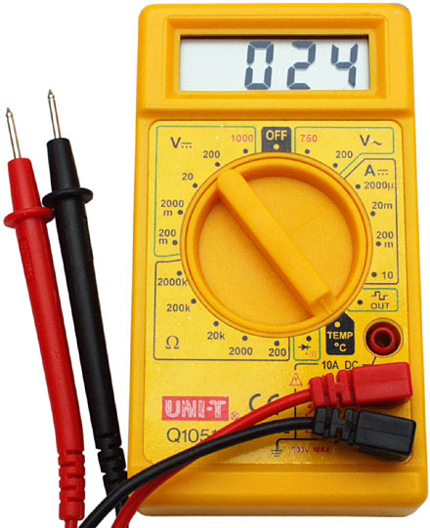
Tools
Breadboard (and wire) Multimeter

Slide 8
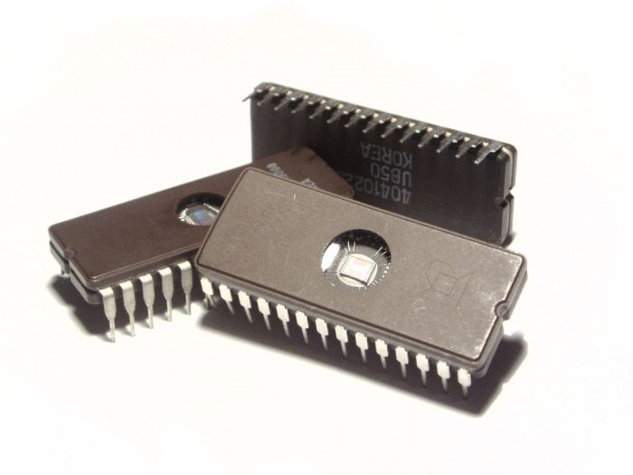
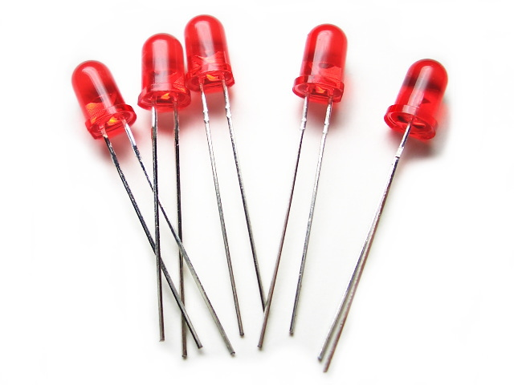
Components
Weekly Components
  555 timer
  Op-amp
  LM3916
  Transistors
Components we will always use
  Resistors
  LEDs
  Voltage supply (battery)
  Capacitors

Slide 9
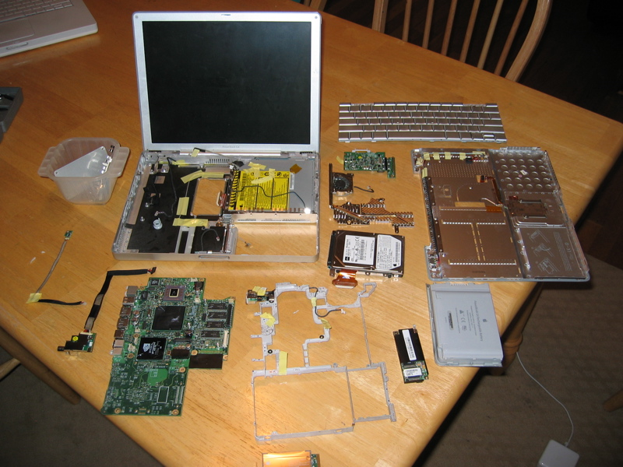
Take Stuff Apart Day

Slide 10
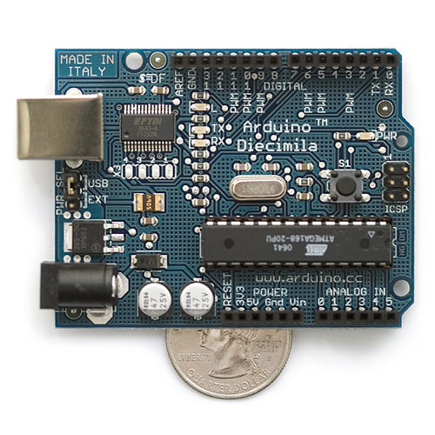
Practical Microcontroller Lab
Idea for next semester’s lab
Uses knowledge gained during this semester
Microcontrollers are fun to play with
You can make very complex electronics with little hardware
Arduino is so easy to use

